Slide 1




Python -
Funksiyalar

Slide 2
Built-in funksiyalar
Function | Description
abs() | Returns the absolute value of a number
all() | Returns True if all items in an iterable object are true
any() | Returns True if any item in an iterable object is true
bin() | Returns the binary version of a number
bool() | Returns the boolean value of the specified object
chr() | Returns a character from the specified Unicode code.
complex() | Returns a complex number
divmod() | Returns the quotient and the remainder when argument1 is divided by argument2
float() | Returns a floating point number
format() | Formats a specified value
hex() | Converts a number into a hexadecimal value
input() | Allowing user input
int() | Returns an integer number
len() | Returns the length of an object
list() | Returns a list
map() | Returns the specified iterator with the specified function applied to each item
max() | Returns the largest item in an iterable
min() | Returns the smallest item in an iterable
next() | Returns the next item in an iterable
oct() | Converts a number into an octal
ord() | Convert an integer representing the Unicode of the specified character
pow() | Returns the value of x to the power of y
print() | Prints to the standard output device
range() | Returns a sequence of numbers, starting from 0 and increments by 1 (by default)
reversed() | Returns a reversed iterator
round() | Rounds a numbers
set() | Returns a new set object
slice() | Returns a slice object
sorted() | Returns a sorted list
str() | Returns a string object
sum() | Sums the items of an iterator
tuple() | Returns a tuple
type() | Returns the type of an object
vars() | Returns the __dict__ property of an object

Slide 3
Funksiya nima?
def greet(name): print('Hello ', name)
greet(“World”)
# Output: “Hello World”
Funksiya bu – dasturdagi blok ichiga olingan va nomlangan amallar ketma-ketligidir.
Funksiyani istalgan payt xohlagancha chaqirish mumkin

Slide 4
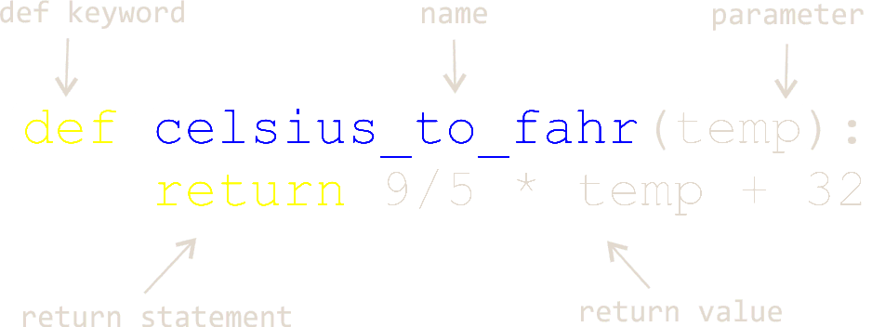
Funksiya anatomiyasi

Slide 5
def square(number): return number * number def cube(number):
return number * square(number)
print(“Square of 2 is”, square(2))
print(“Cube of 3 is”, cube(3))
Misollar

Slide 6
def ask_name(): return name
name1 = ask_name() name2 = ask_name() print("Hello", name1) print("Hello", ask_name())
Funksiyadan natija sifatida ma’lumot olish mumkin.
Ya’ni funksiya natija sifatida ma’lumot qaytarishi mumkin

Slide 7
Arbitrary Arguments, *args
Agar funksiyaga nechta argument berish lozimligini bilmasangiz, u holda kiruvchi parameter oldida * belgisini qo’ying.
Shu holda siz funksiyani chaqirganda kiruvchi parameterga bir nechat argument (to’plam) berishingiz mumkin bo’ladi.
def print_max(*nums): print('Max number is ', max(nums)) print_max(1) print_max(-4, 5) print_max(7, 6, 15, 1, 5) print_max(17, 61, 115, 12, 54, 25, 3, 45, 78)

Slide 8
Keyword Arguments
Funksiyaga argumentlarni key=value tarzida bersa ham bo’ladi.
Bunda argumentlar tartibining ahamiyati yo’q
def calc(num1, num2, num3): num1 += num2 return num1 / num3 result = calc(num2=5, num3=2, num1=7) print(result)

Slide 9
Arbitrary Keyword Arguments, **kwargs
def about(**user): print("User's e-mail: " + user["email"]) about(email='test@gmail.com', username='test')
Agarda funksiya argumentlari uchun nechta nom kerakligini bilmasangiz unda funksiyani elon qilayotganda parameter nomini oldida ** belgilarni qo’ysangiz kifoya
Bunday holatda funksiya argumentlardan iborat dictionary qabul qiladi
def calc(**nums): result = nums["first"] + nums["second"] return result result = calc(first=5, second=2, third=7) print(result)

Slide 10
Default Parameter Value
def my_func(lang='Python'): print("I'm learning " + lang) my_func() my_func('Java') lang = 'Java Script' my_func(lang) my_func(input("Enter programming language: "))
Agarda siz funksiyani argumentlarsiz chaqirmoqchi bo’sangiz default qiymatdan foydalanishingiz kerak.

Slide 11
Docstrings
Pythonda docstring document sifatida foydalaniladi.
Docstringni funksiya, method, class va modullarda e’lon qilingandan keyingi qatorda yozish orqali ishlatish mumkin.
def square(n): '''Takes in a number n, returns the square of n''' return n ** 2 print(square.__doc__) help(square)

Slide 12
Global variables
def after(year): global current_year current_year = 2020 print("{} yildan keyin {} bo'ladi".format(year, current_year + year)) def before(year): print("{} yil oldin {} bo'lgan edi".format(year, current_year - year)) after(5) # after funksiya beforedan oldin chaqirilishi kerak before(10)

Slide 13
Lambda function
Lambda funksiya bu – kichik anonym ya’ni nomsiz funksiyadir
Lamda funksiya xohlagancha argument qabul qilishi mimkin lekin bittadan ortiq ifodaga ega bo’la oldi
cube = lambda x: x ** 3 print(cube(5))
Syntax
lambda arguments : expression

Slide 14
Recursion
Rekursiya keng tarqalgan matematik va dasturiy tushunchadir.
Funksiyaning o’zini-o’zi chaqirish hodisasiga rekursiya deb aytiladi. Bunda funksiayning ichidan turib o’ziga murojat qilinadi
Rekursiyani juda ehtiyotkorlik bilan ishlatish kerak, chunki bunda dastur hech qachon to’xtamaydigan bo’lib qolishi ehtimoli yuqori.
Ammo to'g'ri yozilganda rekursiya dasturlash uchun juda samarali va matematik jihatdan optimal yondashuv bo'lishi mumkin.
def factorial(x):
"""This is a recursive function
to find the factorial of an integer"""
if x == 1:
return 1
else:
return (x * factorial(x-1))
num = 3
print(
"The factorial of", num,
"is", factorial(num)
)

